Slide 1
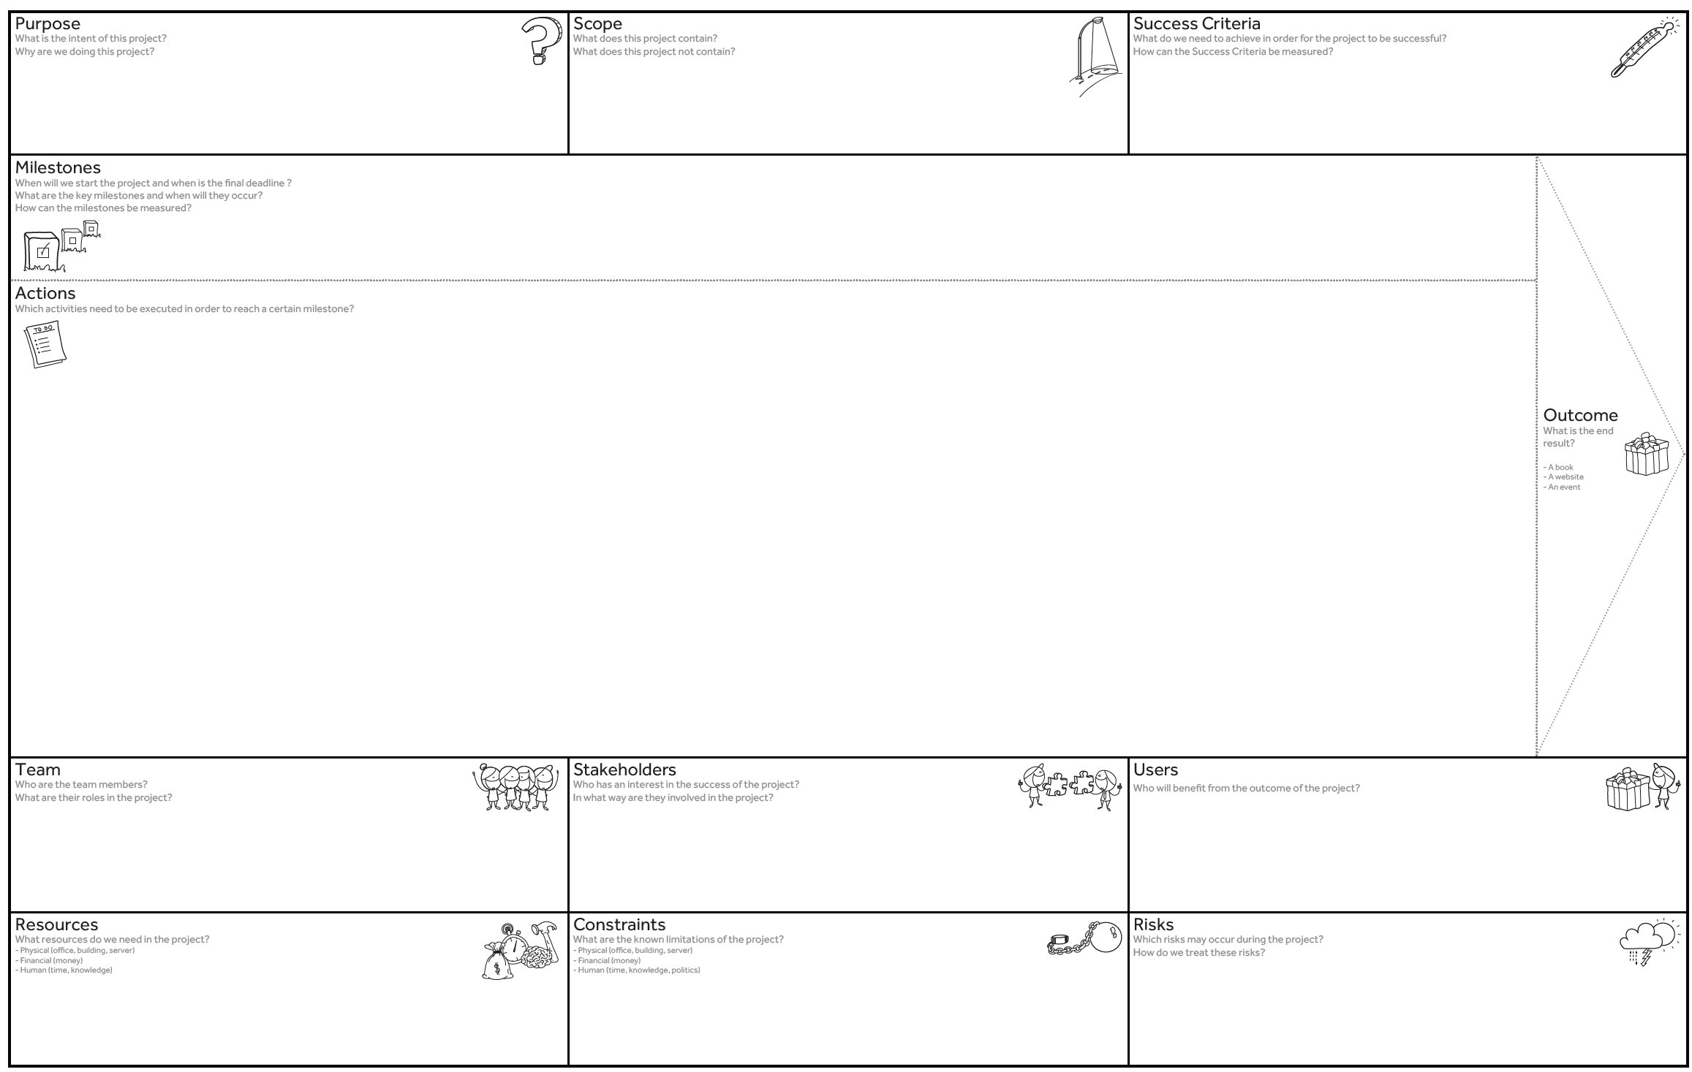
We want to generate speech for low-resource languages from speech and machine translated transcripts to allow training of Corti’s machine learning model for emergency call assistance.
We want to focus on generating speech using WaveNet-like models. Machine-translation and ASR models is out of scope.
Gain performance requisted by Corti (word error rate of 15% on librispeech light model)
Iteration 2
(22/02/2021)
Overview of litterature and project plan
Implement WaveNet (vanilla) without text conditioning
Implement WaveNet with text conditioning
Statistically evaluate conditioned WaveNet using ASR on emergency calls
Write report
A working WaveNet model for generating speech in low-ressource languages and a report that documents model performance
Project Canvas
Data augmentation and processing
Transcript embeddings
Setup ASR model (from external source)
Document and discuss results in report (IMRAD format)
Gannt diagram
Implementation of architechture
Incorporate transcript embeddings into WaveNet model
Evaluate WaveNet model using multiple statistical methods
Collaboration contract
Project presentation
Research litterature
Training and evaluation
Visualization of results
Describe desired learning outcome
4 students
1 DTU counselor (Morten Mørup)
1 Corti counselor (Lars Maaløe)
Corti (counselor and recipient)
Morten Mørup (counselor)
Beneficiaries: Patients of emergency dispatch centers (in multiple countries with a low-ressource languages).
Recipient: Corti
Corti: Emergency calls and ASR model
DTU Compute: HPC
Research and counselling
Public TTS dataset
Corona (lower efficiency and plausible death)
The distribution of time is skewed regarding the possible time we can use before and in the exam period.
No physical meetings.

